Slide 1
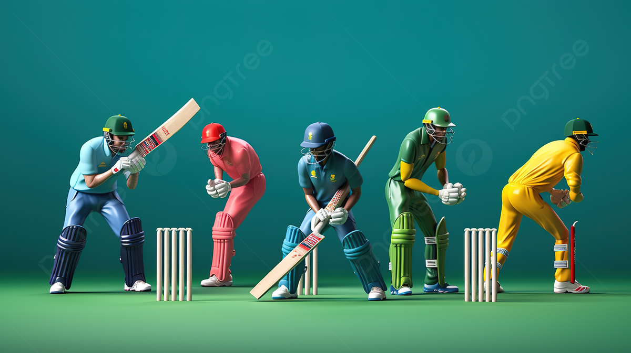
T20 Men’s World Cup 2022 Analysis .

Slide 2
Created a Power BI Dashboard which helps to review and compare performances of all the players in T20 Men's Cricket World Cup 2022 tournament. This dashboard also enables us to select the best eleven of the tournament based on their performance based on defined selection criteria which is included as a part of problem statement. Data Collection: Scrapped all the data regarding match and world cup from www.espncricinfo.com and all details about players career from cricbuzz.com using Beautiful Soup library of Python. Data Transformation: Performed initial data cleaning after scrapping such as player name correction, match id linking etc. using Pandas. Transformed the final data for dashboard using Power Query of Power BI. Data Modelling: Connected all the datasets with based on some defined primary keys such as team and match ids. Also, created many measures, calculated columns and parameters for data analysis and dash boarding using DAX. Dashboard: Created final dashboard using Power BI visuals.

Slide 3
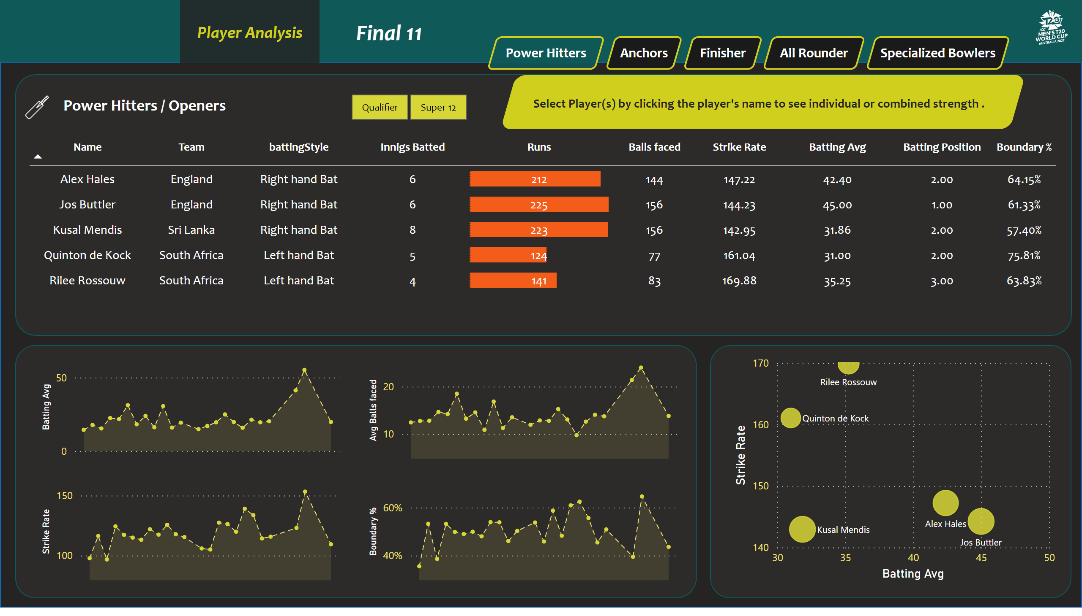
Power Hitters
Notes:
tableEx
No alt text provided
areaChart
No alt text provided
areaChart
No alt text provided
areaChart
No alt text provided
areaChart
No alt text provided
scatterChart
No alt text provided
slicer
No alt text provided
textbox
No alt text provided
image
No alt text provided
shape
No alt text provided
image
No alt text provided
shape
No alt text provided
shape
No alt text provided
shape
No alt text provided
shape
No alt text provided
actionButton
No alt text provided
actionButton
No alt text provided
actionButton
No alt text provided
actionButton
No alt text provided
actionButton
No alt text provided
actionButton
No alt text provided
actionButton
No alt text provided
card
No alt text provided
card
No alt text provided
card
No alt text provided
card
No alt text provided
shape
No alt text provided
shape
No alt text provided

Slide 4
Insights :
Here the first page gives us the detail description about the ‘power hitters’ according having batting strike rate > 140 , boundary % > 50.00% , batting average > 30.
The scatter plot shows clearly that ‘ Jos Buttler ‘ has higher batting average of 45 and strike rate 144.23 than other players .
But other side ‘ Rilee Rossouw ‘ have greater strike rate of 169.88 which is the good thing we found for team building .
The Power Hitters must with a pair of 2 , here in the given table we can observe that the pair of ‘Alex Hales’ and ‘Quinton de Kock’ have higher strike rate which gives us the more chances to win the match .
‘Quinton de Kock ‘ has higher boundary % of 75.81% which will be more important during runs scoring .

Slide 5
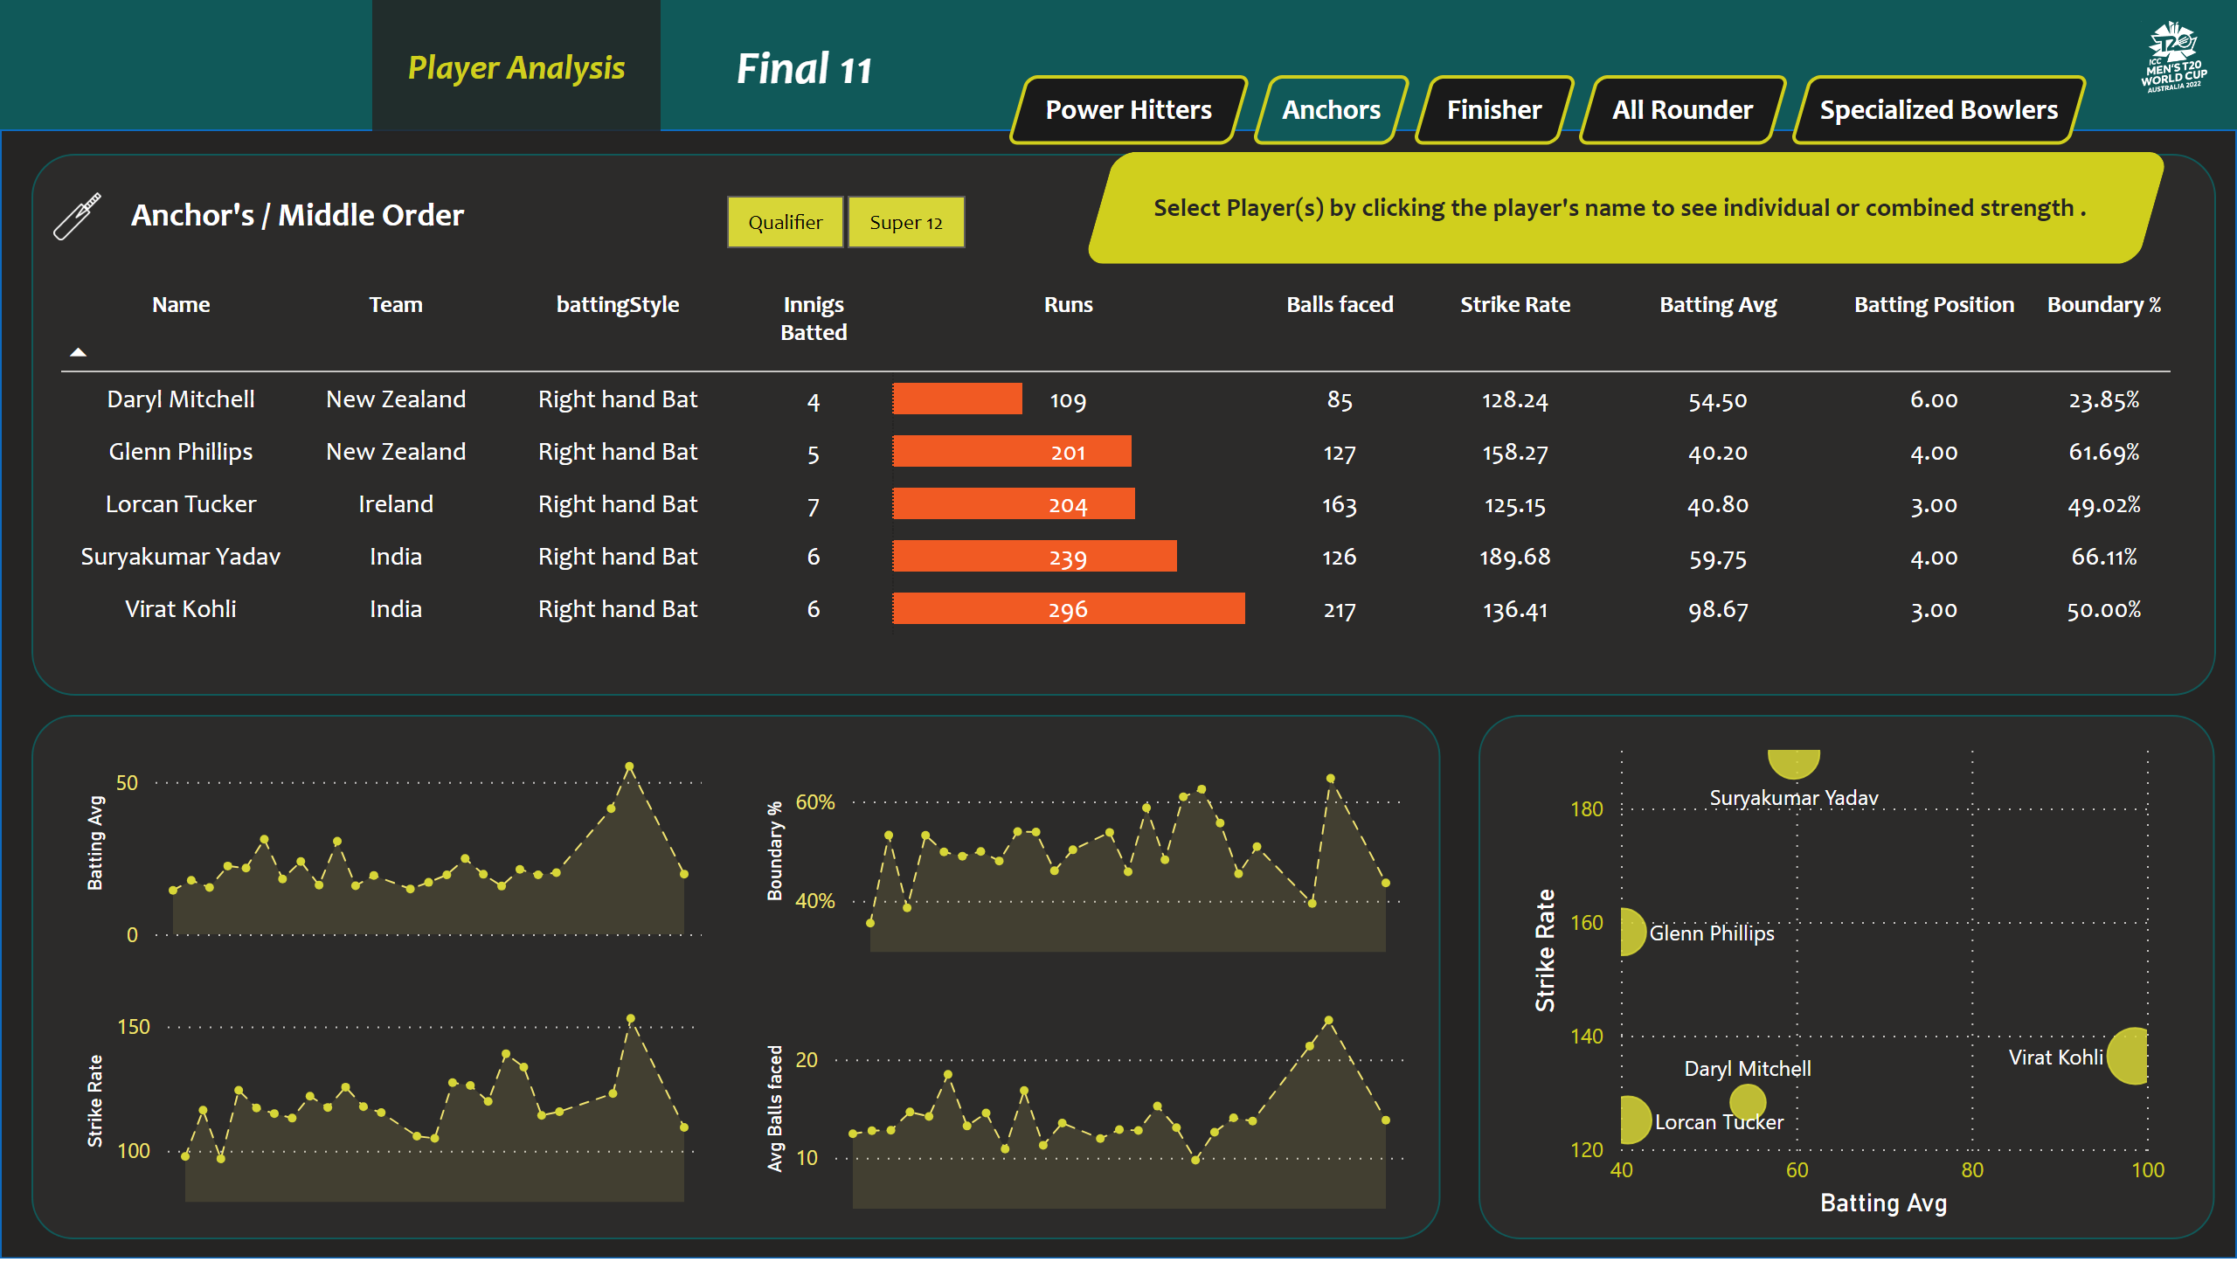
New Anchors / Middle Order
Notes:
textbox
No alt text provided
image
No alt text provided
scatterChart
No alt text provided
tableEx
No alt text provided
shape
No alt text provided
slicer
No alt text provided
shape
No alt text provided
image
No alt text provided
areaChart
No alt text provided
areaChart
No alt text provided
areaChart
No alt text provided
areaChart
No alt text provided
shape
No alt text provided
shape
No alt text provided
shape
No alt text provided
actionButton
No alt text provided
actionButton
No alt text provided
actionButton
No alt text provided
actionButton
No alt text provided
actionButton
No alt text provided
actionButton
No alt text provided
actionButton
No alt text provided
card
No alt text provided
card
No alt text provided
card
No alt text provided
card
No alt text provided
shape
No alt text provided
shape
No alt text provided

Slide 6
Insights :
Here the top 5 middle order batsman or Anchor’s are selected through the criteria of batting average > 40 , strike rate > 125 , balls faced > 20 .
‘Virat Kohli ‘ is having higher batting average for middle order is 98.67 and then ‘Suryakumar Yadav ‘ is of batting average 59.75.
‘ Virat Kohli ‘ Scored 296 runs in 6 innings which is the highest score ever.
The Partnership of Suryakumar Yadav and Dayl Mitchell is higher in strike rate of 164.93 .

Slide 7
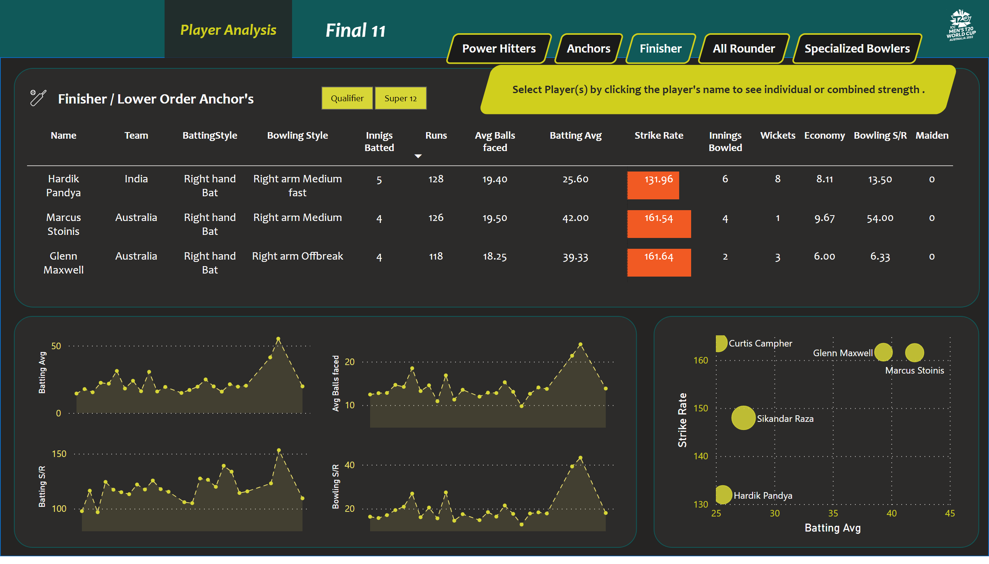
Finisher / Lower order anchor
Notes:
scatterChart
No alt text provided
textbox
No alt text provided
tableEx
No alt text provided
shape
No alt text provided
slicer
No alt text provided
shape
No alt text provided
image
No alt text provided
areaChart
No alt text provided
areaChart
No alt text provided
areaChart
No alt text provided
areaChart
No alt text provided
shape
No alt text provided
shape
No alt text provided
shape
No alt text provided
image
No alt text provided
actionButton
No alt text provided
actionButton
No alt text provided
actionButton
No alt text provided
actionButton
No alt text provided
actionButton
No alt text provided
actionButton
No alt text provided
actionButton
No alt text provided
card
No alt text provided
card
No alt text provided
card
No alt text provided
card
No alt text provided
shape
No alt text provided
shape
No alt text provided

Slide 8
Insights :
Here the top 3 lower order batsman or Finishers are selected through the criteria of batting average > 25 , strike rate > 130 , balls faced > 12.
Glenn Maxwell is from Australia who has higher strike rate 164.64 along with batting average of 39.33
Marcus Stoinis is one who can is same like a Glenn Maxwell having batting strike rate 161.54, also he has higher bowling strike rate 54.00.

Slide 9
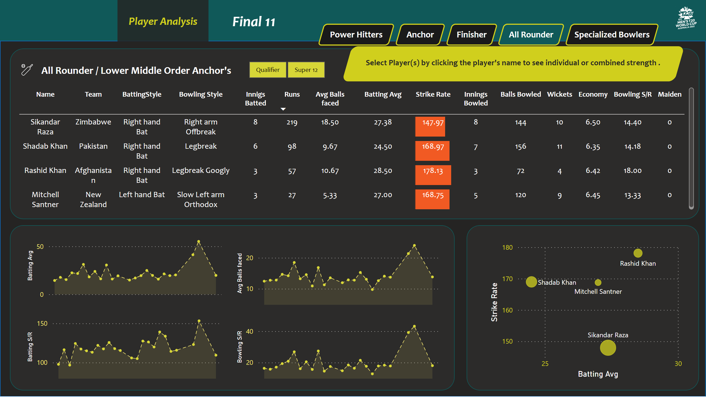
All rounder / Lower Middle order anchors
Notes:
scatterChart
No alt text provided
textbox
No alt text provided
shape
No alt text provided
image
No alt text provided
slicer
No alt text provided
shape
No alt text provided
tableEx
No alt text provided
areaChart
No alt text provided
areaChart
No alt text provided
areaChart
No alt text provided
areaChart
No alt text provided
shape
No alt text provided
shape
No alt text provided
shape
No alt text provided
image
No alt text provided
actionButton
No alt text provided
actionButton
No alt text provided
actionButton
No alt text provided
actionButton
No alt text provided
actionButton
No alt text provided
actionButton
No alt text provided
actionButton
No alt text provided
card
No alt text provided
card
No alt text provided
card
No alt text provided
card
No alt text provided
shape
No alt text provided
shape
No alt text provided

Slide 10
Insights :
Here the All rounder are selected through some basic criteria having batting average > 15 , batting strike rate > 140 , bowling strike rate < 20 .
Rashid Khan is the player who has batting average 28.50 , strike rate 178.13 along with economy 6.42 .
Also bowling strike rate is higher than than all other players is 18.00.
Shadab Khan is second most player after Rashid who is having batting average 168.97 with bowling strike rate 6.35 , wickets earn are 11.

Slide 11
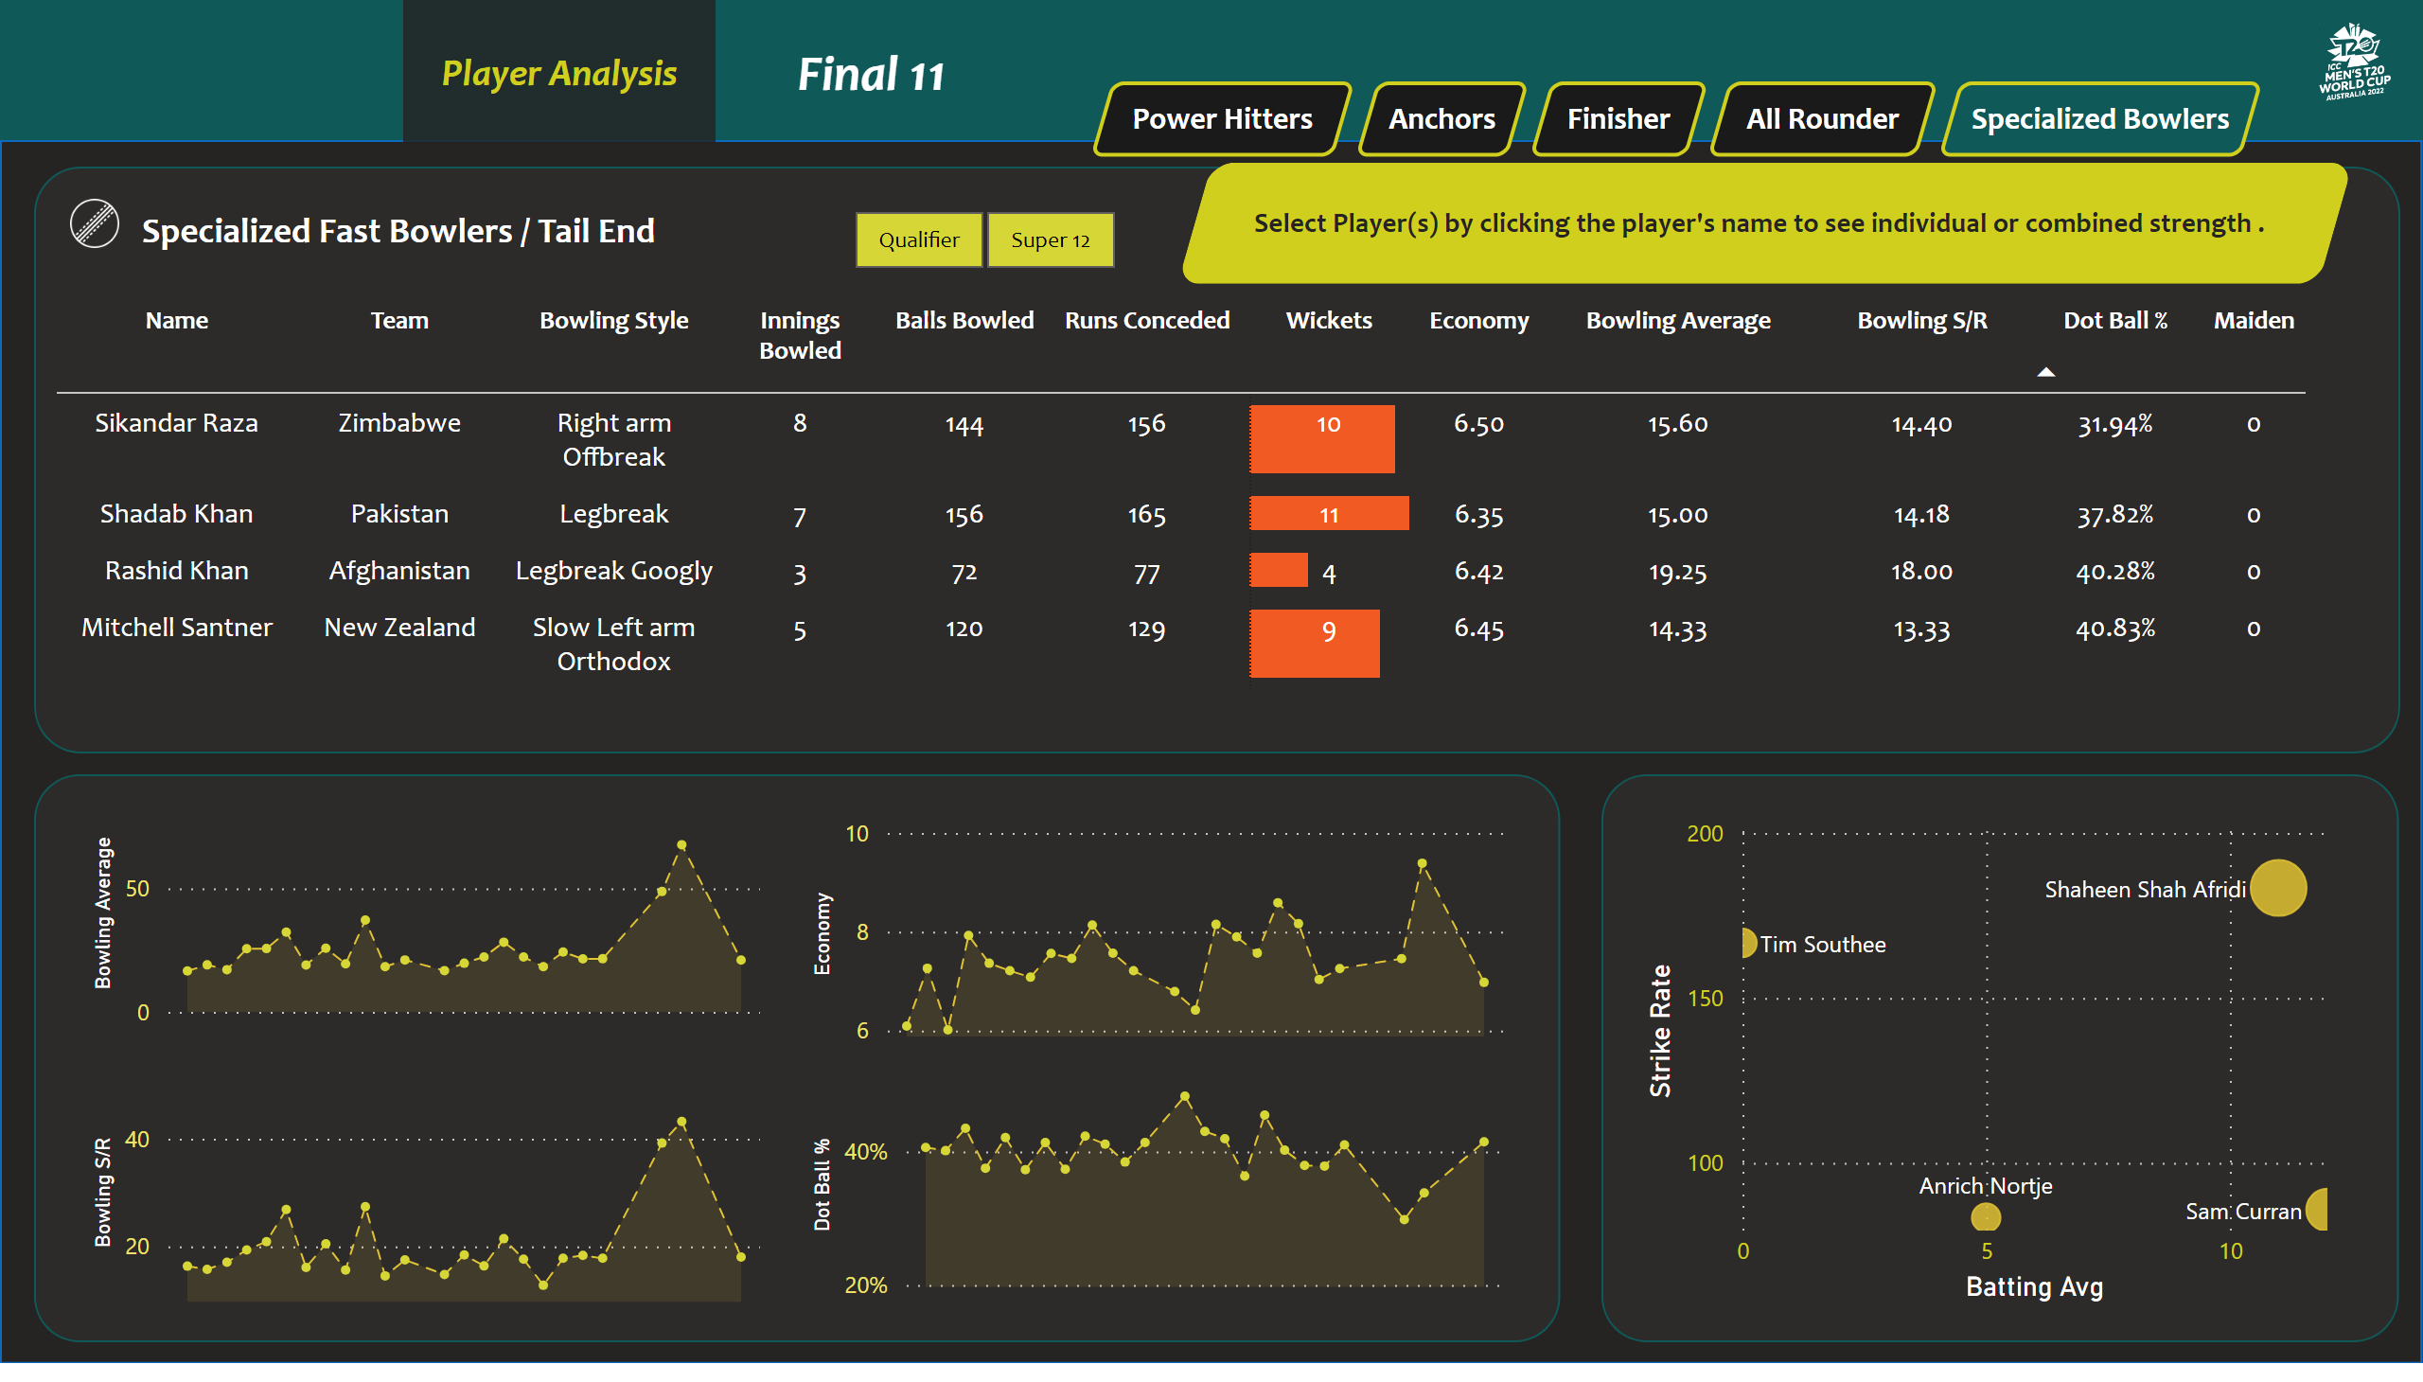
Specialized Fast Bowlers
Notes:
scatterChart
No alt text provided
textbox
No alt text provided
image
No alt text provided
shape
No alt text provided
slicer
No alt text provided
shape
No alt text provided
tableEx
No alt text provided
shape
No alt text provided
areaChart
No alt text provided
areaChart
No alt text provided
areaChart
No alt text provided
areaChart
No alt text provided
shape
No alt text provided
shape
No alt text provided
image
No alt text provided
actionButton
No alt text provided
actionButton
No alt text provided
actionButton
No alt text provided
actionButton
No alt text provided
actionButton
No alt text provided
actionButton
No alt text provided
actionButton
No alt text provided
card
No alt text provided
card
No alt text provided
card
No alt text provided
card
No alt text provided
shape
No alt text provided
shape
No alt text provided

Slide 12
Insights :
At the end the list of fast or specialised bowlers are foundout with the criteria of bowling strike rate < 20 , innings bowled > 2 , batting position > 4 , batting strike rate >140.
Shadab Khan is the bowler who has taken 11 wickets in 7 innings which is the highest score in the table .
Sikhandar Raza is the one who has higher economy of 6.50.
Rashid Khan is having greater bowling strike rate of 18.00.

Slide 13
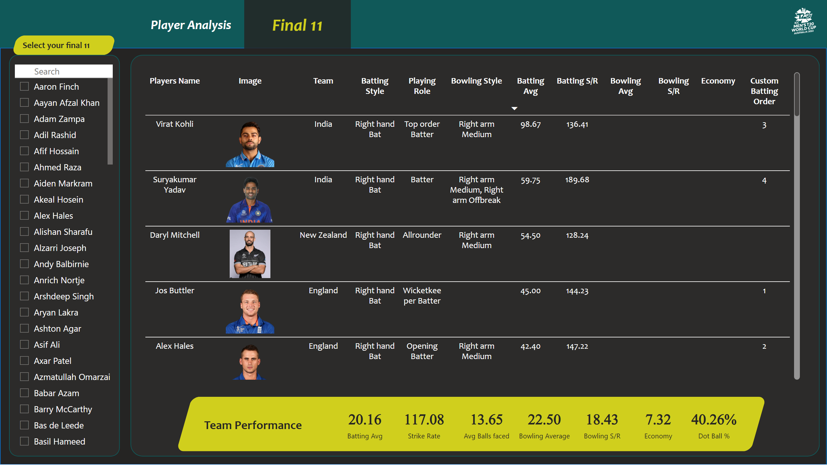
Final 11
Notes:
slicer
No alt text provided
card
No alt text provided
card
No alt text provided
card
No alt text provided
card
No alt text provided
card
No alt text provided
card
No alt text provided
card
No alt text provided
textbox
No alt text provided
shape
No alt text provided
shape
No alt text provided
shape
No alt text provided
textbox
No alt text provided
image
No alt text provided
shape
No alt text provided
shape
No alt text provided
tableEx
No alt text provided
actionButton
No alt text provided
actionButton
No alt text provided

Slide 14
Thank You !

